Slide 1
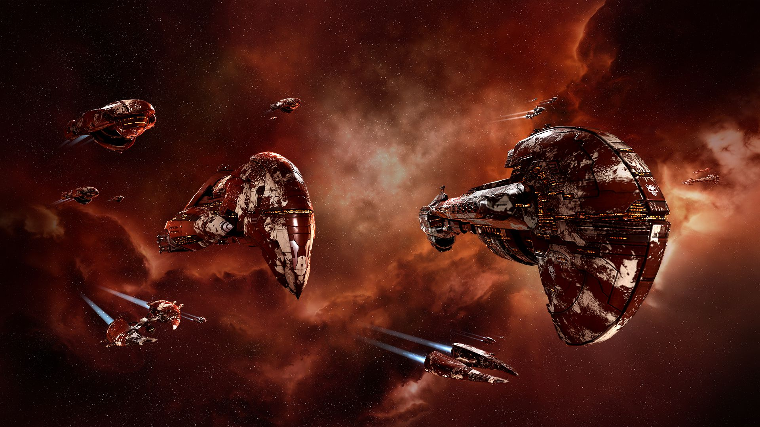
Massive Fleet fights in eve online
Freyr Magnusson
CCP Games
Notes:
Freyr Magnússon
Senior Software Engineer
CCP Games
Single Sharded Persistent Universe
Everyone is on the same server
Over 8000 solar systems to visit

Slide 2
Notes:
This is EVE trailer
MMOG
Single Sharded Persistent Universe
Everyone is on the same server
Over 8000 solar systems to visit
https://www.youtube.com/watch?v=AdfFnTt2UT0

Slide 3
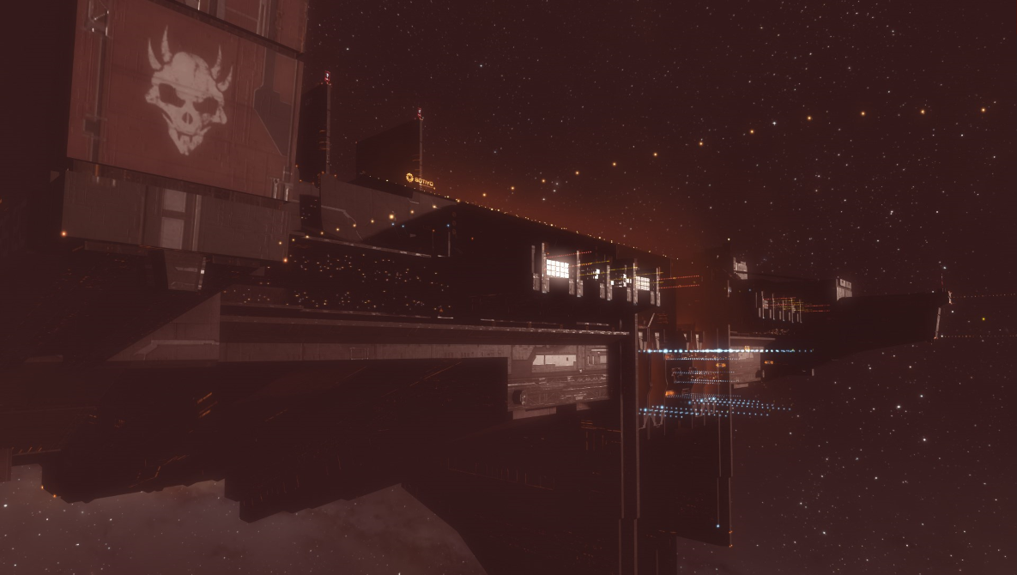
Blood Raider Shipyard
Provide Player vs Environment Fleet Fight Experience
Deliver High End Loot
Large Scale Group Content
Feels Like Fighting Players
Notes:
Last summer we released a feature called Blood Raider Shipyards.
It introduced large scale fleet fights between players and NPCs
Hundreds of NPC ships fighting and trying to emulate player behavior while defending a massive Shipyard.

Slide 4
Blood Raider Shipyard: Overview
Notes:
Let’s do a quick overview of how this feature works.

Slide 5
Blood Raider Shipyard: Overview
Notes:
We start with a massive pirate shipyard that players have to search for and locate.

Slide 6
Blood Raider Shipyard: Overview
Notes:
When the players get close the pirates will respond by deploying a defensive fleet
If the players stick around or bring friends we will keep spawning reinforcements until the players give up or take down the shipyard shields

Slide 7
Blood Raider Shipyard: Overview
Reinforced
for
24 Hours
Notes:
When the players manage to get through the shields, the shipyard it enters reinforced mode.
It becomes invulnerable for 24 hours and stops spawning reinforcements.

Slide 8
Blood Raider Shipyard: Overview
Hi!
Notes:
When the shipyard exits reinforced mode it becomes visible to everyone in the solar system.
And the cycle starts again. Players arrive. Pirates Respond. More players and more pirates.
But now there is a significantly higher chance of a rival group of player wanting in on the fun.
Which will escalate the defenses as well.

Slide 9
Mining Operations
Notes:
Before we go it more detail about the Shipyards I want to talk a bit about the feature we did prior.
In 2016 we released a feature dubbed Mining Operations.
There we introduced small scale fleet fight in the form of NPC miners and their defense fleets.
These are NPCs mining fleets that show up at asteroid belts and compete with players for the resources.
We are still getting bug reports that they min out entire asteroid belts.

Slide 10
Mining Operations: Miners and Haulers
Venture
Procurer
Retriever
Impel
Badger
Notes:
We created NPC mining gangs complete with haulers to collect the ore.
They compete with the players for valuable ore in the asteroid belts.
If you destroy miners or hauler they can drop the collected ore as loot along with some extra swag if you get the haulers.

Slide 11
Reusable NPC Ship Types
Notes:
In an attempt to mirror player behavior better and make it simpler for players to understand our feature
We introduced reusable NPC types that can we shared between different factions.
As part of that we introduced dynamic skinning on NPCs using the same tech as player ship skins.

Slide 12
Mining Operation: Defenders
Kestrel
Executioner
Tristan
Breacher
Celestis
Caracal
Maller
Vexor
Scythe
Raven
Rupture
Notes:
And when attacked we call in reactionary forces to defend them.
We had forces from 12 different NPC corporations from the 4 main races
And 5 different pirate factions in addition.

Slide 13
Emulating Player Fleets
Notes:
We introduced player like stats based on real ship loadouts
We wanted NPC ships to better match player expectation based on how players would these ships
We still haven’t not able to assemble these ships dynamically
We still have to create new types for each fitting we need.

Slide 14
Distinct NPC Combat Roles
Commander
Logistics
Electronic Warfare
DPS
Tackler
Notes:
For the defense forces protecting the miners we created different roles similar to what you find in player fleets.
Commander, DPS (damage dealers), Logistics, Electronic Warfare, DPS
Anti-Logistics
Anti-DPS
Commander chosen from the DPS
Iceland Just Qualified for the World Cup 2018

Slide 15
Flying in Formation
Player
Notes:
To properly take advantage of the our combat roles we needed to fly the NPC in formation similar to how organiized players tend to do.
Given a combat target.

Slide 16
Flying in Formation
Commander
Player
Notes:
The commander chosen from the DSP ships will orbit the target at an effective range base on his weapons.

Slide 17
Flying in Formation
Commander
Player
DPS
Notes:
The other DPS ships will anchor on the Commander by orbiting around him.

Slide 18
Flying in Formation
Tacklers
Commander
Player
DPS
Notes:
Wizard Staff Formation!
How about a video if this in action

Slide 19
Flying in Formation
Tacklers
Commander
Fleet Axis
Player
DPS
Notes:
By drawing a line from the commander though the target we can define a fleet axis.
Enemy Gate is down (Enders Game)

Slide 20
Flying in Formation
Tacklers
Commander
Fleet Axis
Player
DPS
Logistics
Notes:
This allows us to place the logistics begind the Commander and DPS away from the enemy.
within repair module range. They will try to stay on the fleet axis mainaining the right distance.

Slide 21
Flying in Formation
Electronic Warfare
Tacklers
Commander
Fleet Axis
Player
DPS
Logistics
Notes:
Finaly we have the Electronic Warfare ships that will orbit targets and disrupt them as faraway as their EWar moduls allow.
They tend to have very long ranges.
I have dubbed this the Wizardstaff formation

Slide 22
Differing Targeting Requirements
DPS: Attack Primary Target
Primary Target
DPS

Slide 23
Differing Targeting Requirements
Tackler: Tackle Primary and Secondary
Primary Target
Secondary Target
Tacklers

Slide 24
Differing Targeting Requirements
Anti-DPS
Anti-DPS: Disrupt Secondary
Primary Target
DPS

Slide 25
Differing Targeting Requirements
Anti-Logistics: Disrupt Logistics
Logistics
Anti-Logistics

Slide 26
Differing Targeting Requirements
Logistics: Damaged Members in Range
Logistics

Slide 27
Blood Raider Shipyards

Slide 28
Delivering High End Loot
Dagon
Chemosh
Molok
Notes:
End of 2016 our designer pitched a relatively simple feature to deliver some high end player rewards.
We had these cool pirate capital ships but now good way of getting them into the game.

Slide 29
NPC Structures would be cool
Notes:
So lets spawn one of them cool new Enginerring Complexes we just added to our game for our players to build capital ships.
These are massive space stations more tha 100 km accross.
The Avatar exiting there is supposed to be 13 km long for comparisson.
So we took these player strucures and made NPC versions just like them except we add behavior trees and put got them reskinned.
You can actually dock there and use the station facilities if you have the right roles.

Slide 30
Structure Modue Fittings
Notes:
On top of that we spawned these as actual persistent, items complete with fittings like the players use.
The station will take part in the defense and spawned it‘s own defences fleets.

Slide 31
NPC Haulers returning to base
Notes:
These structure where supposed to be super secret hidden pirate bases.
To begin with the only way to find it was to follow a Blood Raider Mining fleet hauler back to base where it would dock up.

Slide 32
Fleet Matching
Periodic Timer
Sum Player Fleet Points
Sum NPC Fleet Points
Spawn NPC From Spawn Table
Determine Intensity
Select Player Fleet to Counter
Classify Player Ships
Assign Spawn Points
Select NPC Counter
Notes:
That brings us to the fleet matching
Every so many minutes the shipyard will analyse the battlefield and go through a series of steps to decide what to spawn.
First we sum upp the point cost of all the detected player ships.
Then we do the same for all our currently surviving NPC defence forces
We determine the current intensity we want
And then assign missing points to spawn
We pick a player fleet we want to counter
Then select an appropriate counter to sawn
Finally we spawn the reinforcements using spawn tables.

Slide 33
Fleet Matching
(player_points * intensity) – npc_points = spawn_points
Notes:
This is how we determine how many points or reinforcements we need to spawn.
Intensity is a multiplyer we can drive dynamically.

Slide 34
Spawn Points
Notes:
Lets talk about spawn points
We created a new way to pick NPC combinations taking hints from our own Alliance Tournament
Where we alreay had created a system to assign point cost to ships to create a framework for balanced
fleets players to fight competitively.

Slide 35
Spawn Points
Rifter
Vengeance
Thrasher
Crow
Kitsune
Thorax
Oracle
Nemesis
Basilisk
Megathron
Chimera
Nyx
Erebus
Naglfar
Absolution
Notes:
We have very large colllection of player ships that we can expect to see.

Slide 36
Spawn Points
Frigate
Assault Frigate
Destroyer
Interceptor
Electronic Attack Ship
Cruiser
Attack Battlecruiser
Stealth Bomber
Logistics
Battleship
Carrier
Super Carrier
Titan
Dreadnought
Command Ship
Notes:
Each of these ships belong to a ship class and these ship classes are in general ment to be internally balanced.

Slide 37
Spawn Points
24
52
33
39
63
45
100
54
186
195
1423
7833
11793
2242
350
Notes:
So we assign a cost to each of these ship classes.
As you can see they cover a very large spectrum from 24 points to nearly 12 thousand points.
These numbers are derived from the effective hitpoints of each ship and a class based multiplier.
And keep in mind that each of these ships are piloted by a single player.
So a group of 100 players can space anyware from 2400 points to 118.000 points.
I wouldn‘t count on seeing 100 Titans very often as they represent huge in game investments.

Slide 38
Spawn Points
8 x
=
Frigate
Battleship
11 x
=
Battleship
Dreadnought
5 x
=
Dreadnought
Titan
Notes:
8x11x5=440
11792/24=491

Slide 39
Spawn Points
Augoror
Arbitrator
Omen
Bhaalgorn
Ashimmu
Cruor
Apocalypse
Chemosh
Notes:
For the Blood Raider NPCs we did the same thing

Slide 40
Spawn Points: Cost
132
45
45
264
69
29
195
2242
Notes:
We calculate comparable point cost for each ship just like with the players ships.

Slide 41
Spawn Points: Tags
SR+LR
SR+LR
SR
LR
SR
SR
LR
Capital
Notes:
We also added tags to each ship that we can use when selecting NPCs to spawn.

Slide 42
Spawn Points: Tags
Cruor
Arbitrator
Omen
Cruor
Bhaalgorn
Arbitrator
Ashimmu
Augoror
Apocalypse
Augoror
Short Range Fleet
Capital Fleet
Long Range Fleet
Chemosh
Chemosh
Notes:
Using the tags we defined three basic fleet compositions
Short Range
Long Range
And Capitals

Slide 43
Spawn Points: Weights
10
10
50
5
50
10
10
25
20
20
Short Range Fleet
Capital Fleet
Long Range Fleet
40
60
Notes:
We also assigned weights to them so we could emphasis particular ships in our fleet compositions

Slide 44
Spawn Tables
Type | Cost | Weight | Tags | Behavior
Cruor | 29 | 10 | Short Range | Tackler
Cruor | 29 | 5 | Long Range | Tackler
Omen | 45 | 50 | Short Range | DPS
Arbitrator | 45 | 10 | Long Range | Anti-DPS
Ashimmu | 69 | 10 | Short Range | Anti-Logistics
Augoror | 132 | 20 | Long Range | Logistics
Bhaalgorn | 264 | 50 | Long Range | DPS
Chemosh | 2242 | 40 | Capital | Anti-SubCapital
Chemosh | 2242 | 60 | Capital | Anti-Capital
Notes:
We created spawn tables to encode all this where we could also assign behavior tree overrides
Allowing us to repurpose the same ship in different roles if we needed.

Slide 45
Intensity
Notes:
The intensity we used was directly proportional to the health of the structure be it status of shield, armor or hull
At full health we had 110% spawn points all the way to 210% when the health was depleting.

Slide 46
Countering Players
Players
Short Range
Long Range
Capital
Other
Short Range
100%
Short Range
50%
Long Range
30%
Capital
20%
Short Range
10%
Long Range
80%
Capital
10%
Short Range
20%
Long Range
20%
Capital
60%
Notes:
We used a simple decision tree to decide what counter to deploy.
We classified the enemies into 4 groups, Short Range, Long Range, Capital and Others
We did a weighted choice using the aggregated damage and healing done over a period by each group.
Then we had different weights for each of our 3 fleet archetypes based on what we where countering.
We wanted to keep a random element the as it makes the pirates less predictable and harder to exploit.

Slide 47
Fleet Awareness
Notes:
To make sense of the battlefield we developed system called Fleet Awareness
It‘s purpose is to simplify tracking of threats in proximity to our NPCs.

Slide 48
Fleet Awareness
NPC Fleet
NPC Fleet
NPC Fleet
Notes:
We have three separate NPC fleets
Using hierarchical cluster analysis we split the NPC into groups based on proximity.

Slide 49
Fleet Awareness
Notes:
We use single linkage clustering for this as it has a very useful property.

Slide 50
Single Linkage Clustering
500 km
30 km
12 km
10 km
28 km
25 km
10 km
4 km
11 km
8 km
5 km
3 km
Notes:
The algorithm gives us a tree of how the clusters merge. The edges represent the distance to the nearest cluster.
So given a threshold we can just walk down the tree and cut the edges that exceed our limit until we hit an edge that us under it.
This way I can enforce a minimum separation between clusters. We end up with a variable number of clusters based on their separation.

Slide 51
Fleet Awareness

Slide 52
Fleet Awareness
Sensor Range
200 km
Outside Threat Range
Separation
500 km
Sensor Range
200 km
Proximity Sensors
Notes:
Now I can easily that my sensors wont overlap
and I can place a single sensor for each of my cluster as needed.
These sensors get updated when the cluster members change or we detect a drift over some threshold.
We only test the clusters every 10 seconds.
The most expensive bit is computing the distance matrix between each NPC in the fleet.
This is not time critical so we can update this in a pretty relaxed manner.

Slide 53
Fleet Awareness
NPC Fleet
Outside Threat Range
NPC Fleet
NPC Fleet
Proximity Sensors
Notes:
So here we have three NPC fleets and the sensor ranges they have.
Next we have to figure out where our enemies are and where to focus our efforts.
It‘s really difficult to anticipate what the players are upto or understand what their strategy is.
And as soon as our player figure out how things work they are pretty good a trying to break it.
So we opted for a fairly simple approach again using hierarchical clustering to split the players into groups
We could

Slide 54
Fleet Awareness
NPC Fleet
Cluster 1
Outside Threat Range
NPC Fleet
Cluster 2
Cluster 3
NPC Fleet
Proximity Sensors
Notes:
So we opted for a fairly simple approach. Again using hierarchical clustering to split the players into groups.
So every player ship with in our sensor range will be included.

Slide 55
Fleet Awareness
NPC Fleet
Cluster 1
Outside Threat Range
NPC Fleet
Cluster 2
Cluster 3
NPC Fleet
Proximity Sensors
Notes:
If a player ship outside our sensor range attacks our NPCs or assists a player already tracked
we add that ship to our threat list.

Slide 56
Fleet Awareness
NPC Fleet
Cluster 1
Outside Threat Range
NPC Fleet
Cluster 4
Cluster 2
Cluster 3
NPC Fleet
Proximity Sensors
Notes:
In addition we remember each threat for 15 minutes after they exit our sensors or offend us in any way.

Slide 57
Fleet Awareness
NPC Fleet
Cluster 1
Outside Threat Range
NPC Fleet
Cluster 4
Cluster 2
Cluster 3
NPC Fleet
Proximity Sensors
Notes:
For each of these groups we rank them according to their combined damage and healing output over a period of time.
This gives us a threat value per cluster and each NPC group will then pick an enemy cluster using a weighted random choice.

Slide 58
Fleet Awareness
NPC Fleet
Cluster 1
Outside Threat Range
NPC Fleet
Cluster 4
Cluster 2
Cluster 3
NPC Fleet
Proximity Sensors
Notes:
For each of these groups we rank them according to their combined damage and healing output over a period of time.
This gives us a threat value per cluster and each NPC group will then pick an enemy cluster using a weighted random choice.

Slide 59
Fleet Maneuvering
Notes:
We implemented so specific fleet maneuvers to deal with specific situations when moving around the battlefield.
To begin with we needed to be able to deal with Warp Disruption Bubbles that players can place in space.
As seen on this image here.

Slide 60
Fleet Maneuvering: Bubbles
Warp Disruption Bubble
Target
NPC
Notes:
Warp Disruption Bubbles a prevent anyone inside it from warping.
So if an NPC found it self inside one we had to deal with that.
We opted for a fairly simple solution of just burning towards the intended target until we get out of the bubble.
In the mean time we will target and shoot at the Bubble Generator to try to take it out.

Slide 61
Fleet Maneuvering: Sniping
Long Range NPC
Target
Safe space
Threat
Notes:
Long Range Fleets have a sniping behavior where
If a threat gets to close they will relocate to a new sniping position
to avoid getting caught and pinned down.

Slide 62
Fleet Maneuvering: Bouncing
Random Point
Warp Away
Warp Back
Too short to warp
Too far to shoot
NPC
Target
Notes:
Bouncing or Ping Warps are ways to quickly relocate on the battlefield.
This will happen when NPC needs to get to a position too close to warp directly but too far away for weapon range to have any effect.
The NPC will pick a random point several hundred km away and warp there before warping back the new destination
The effect in practice due to the random point is observed as starburst warping.

Slide 63
Notes:
You should be watching the Orange brackets which are the pirates.
Notice how they will often scatter in random directions and then converge again at a location.
The red ships are super fast frigates orbiting and shooting the shipyard making very hard for our pirates to catch them and kill.
NOTE: through out the linked video you can see the AI ships repositioning. The segment I showed was around 24:30 into the video.
https://youtu.be/fQlCeaHwGwY?t=24m30s

Slide 64
Will you look at the time!

Slide 65
Notes:
CCP made SCOPE video release right after the first shipyard was put into reinforced mode
https://www.youtube.com/watch?v=HIN973qCxyo

Slide 66
Notes:
Note from Freyr:
This is a recording of the Imperium Alliance taking down the Shipyard and the chaos that followed.
The whole scene is over an hour long.
The orange brackets are the AI controlled Blood Raider Defence Fleets
The red brackets are Imperium Alliance Player ships taking down the shipyard with mostly very fast cheap frigates.
The blue brackets are TEST Alliance Please Ignore and are there to harrass the Imperium and then steal their loot if they can. Which they did.
The gray brackets are 3rd player faction also there to mess with the Imperium.
The video starts as the Shipyard is exiting reinforced mode and starts spawing NPC AI ships.
The video ends with the Shipyard destruction and the subsequent sacking.
https://www.youtube.com/watch?v=fQlCeaHwGwY
https://youtu.be/fQlCeaHwGwY?t=1m00s exiting reinforced mode
https://youtu.be/fQlCeaHwGwY?t=1h2m15s Imperium reinforcements arrive right before the Shipyard goes down to help control the battlefield and prevent enemies looting
https://youtu.be/fQlCeaHwGwY?t=1h5m45s The final destruction of the shipyard

Slide 67
Where‘s my loot?
Notes:
The first shipyard droped a Titan and a Dreadnought blueprint
Those got snached by a TEST pilots from the Imperium
That TEST pilot got shot down and the Dreadnought blueprint was destroyed but the Titan blueprint got picked up
By this other TEST pilot Hudders which also got shot down and the Titan blueprint was also destroyed.
So nobody got the juicy loot that time.
Next time the shipyard got completed the Molok Titan blueprint dropped but got stolen by a friendly and auctioned off for vast sums of Internet Space Kredits.

Slide 68
From hundreds to a few
500-600 players involved in first shipyard
NPC shipyard destroyed ever 1 – 2 weeks
9-10 Super Carriers

Slide 69
Where do we go from here?
More Shipyards with different factions
Scaling down the content
Adding more fleet archetypes to counter with
Better analyzes of player doctrines and behavior
Formalizing Fleet Counters
Improve Target Management
Improving Fleet Navigation and Maneuvering
Unifying behavior trees and configure dynamically
Notes:
We are now expanding the content to more factions and space in game.
We are scaling the content down and making it more accessible
We have started formalizing the fleet counter mechanics and moving that into tabular structured form.
We need to flesh out more counters and more fleet archetypes so we can deal better with specific player doctrines.
We need to work on our targeting management to deal with all the different requirements different roles have
We need to work on our navigation systems to simplify behaviors and make them more robust.
We need to unify our behavior trees and find better ways to parametrize them and give context.
We need to work on our ability to read the battlefield and give context to spawn mechanics and behavior.

Slide 70
Questions and Answers?

